Slide 1

Geometry
Unit 5, Lesson 10 Congruence in Two-Dimensional Figures – Part 2 Volume 1, pg. 276

Slide 2


Benchmark
MA.912.GR.1.6
Solve mathematical and real-world problems involving congruence or similarity in two-dimensional figures.
volume 1, pg. 276

Slide 3
Integrated Mathematical Thinking and Reasoning Standards
MA.K12.MTR.1.1 Actively participate in effortful learning both individually and collectively.
MA.K12.MTR.3.1 Complete tasks with mathematical fluency.
MA.K12.MTR.4.1 Engage in discussions that reflect on the mathematical thinking of self and others.
MA.K12.MTR.5.1 Use patterns and structure to help understand and connect mathematical concepts.
MA.K12.MTR.7.1 Apply mathematics to real-world contexts.
volume 1, pg. 276

Slide 4

Learning Target
I can solve real-world problems involving congruence.
volume 1, pg. 276

Slide 5

Warm-Up
volume 1, pg. 277

Slide 6
5.10.1 Warm-Up: Notice and Wonder
A table of menu prices is shown.
Burgers | Chips | Fries
Deluxe Burger | $6.90 | $7.70
Deluxe Cheese | $7.70 | $8.45
Bacon Burger | $7.95 | $8.65
Bacon Cheese | $8.25 | $8.95
Double Burger | $8.35 | $9.30
Double Cheese | $9.25 | $9.95
Double Bacon Cheese | $9.50 | $10.25
Cheese Garden Burger | $8.25 | $8.85
Mushroom Swiss | $8.25 | $8.95
Jalapeno Pepper Jack | $8.25 | $8.95
BBQ Western Bacon | $9.20 | $9.85
Pastrami Burger | $9.20 | $9.85
Power Pac | $10.45 | $11.05
Cheese Power Pac | $11.25 | $11.70
volume 1, pg. 277

Slide 7
What do you notice about prices of the burgers with cheese?
What do you notice about ordering chips versus fries?
There is a price difference between adding chips or fries with a double burger and adding chips or fries with cheese garden burger. Do you think this means that when you order a double burger you get more fries?
When you look at a menu, do you consider the price differences or just order what you would like to eat?
volume 1, pg. 277

Slide 8

Guided Instruction
volume 1, pg. 277

Slide 9
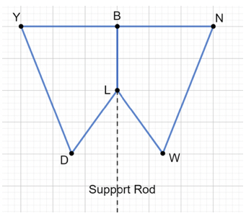
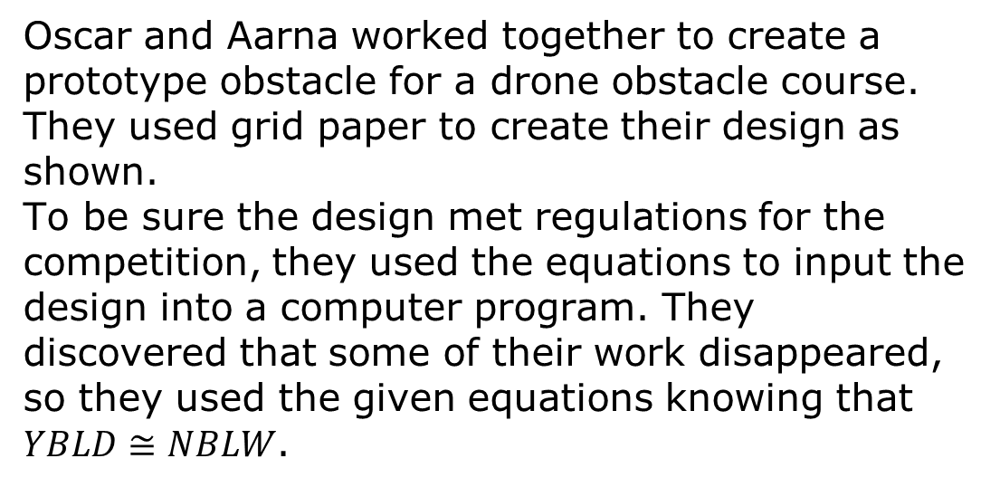
5.10.2 Guided Instruction: Corresponding Parts in the Real World
Oscar and Aarna worked together to create a prototype obstacle for a drone obstacle course. They used grid paper to create their design as shown.
To be sure the design met regulations for the competition, they used the equations to input the design into a computer program. They discovered that some of their work disappeared, so they used the given equations knowing that $YBLD≅NBLW$.
volume 1, pg. 277

Slide 10

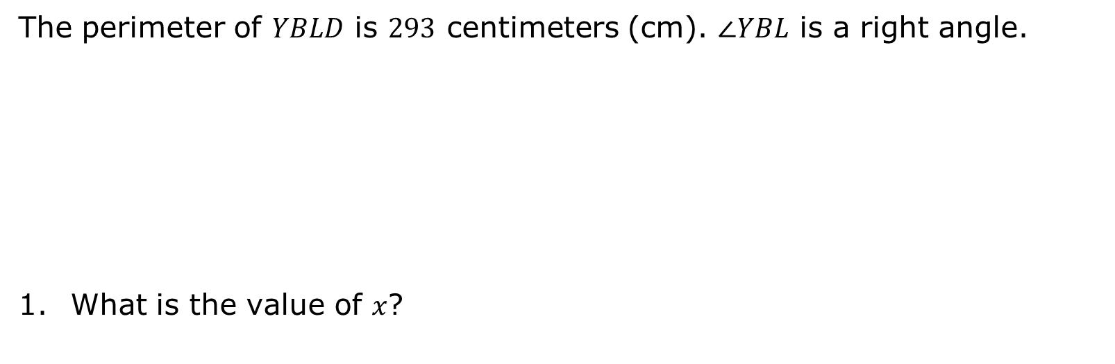
The perimeter of $YBLD$ is $293$ centimeters (cm). $∠YBL$ is a right angle.
What is the value of $x$?
$YB=75$ cm | $WL=\left(3x+10\right)$ cm | $$m∠LWN=\left(4k+9\right)°$$
$$m∠DLB=\left(12k+1\right)°$$ | $WN=(6x+5)$ cm | $LB=50$ cm
$$m∠BYD=\left(5k+8\right)°$$
volume 1, pg. 277

Slide 11
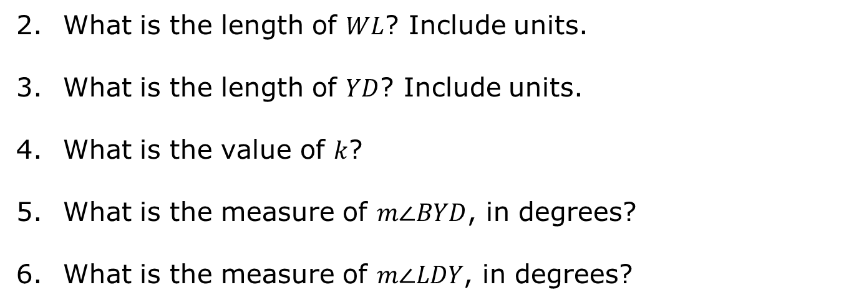
What is the length of $WL$? Include units.
What is the length of $YD$? Include units.
What is the value of $k$?
What is the measure of $m∠BYD$, in degrees?
What is the measure of $m∠LDY$, in degrees?
volume 1, pg. 278

Slide 12

Collaboration
volume 1, pg. 278

Slide 13

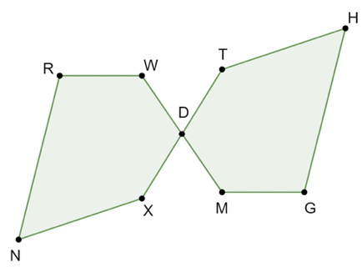
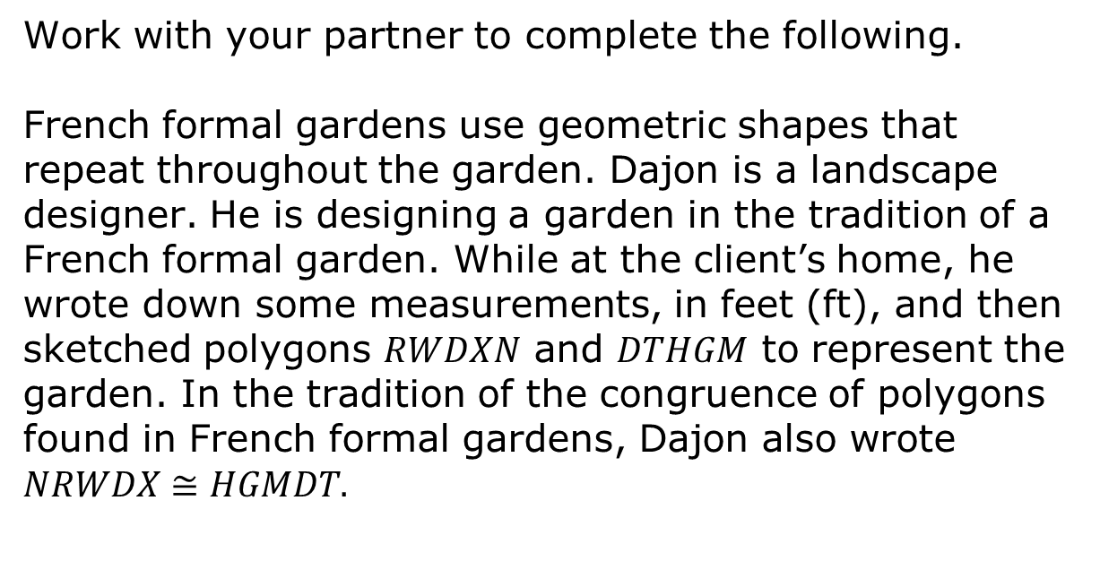
5.10.3 Collaboration: Corresponding Parts in the Real World
Work with your partner to complete the following.
French formal gardens use geometric shapes that repeat throughout the garden. Dajon is a landscape designer. He is designing a garden in the tradition of a French formal garden. While at the client’s home, he wrote down some measurements, in feet (ft), and then sketched polygons $RWDXN$ and $DTHGM$ to represent the garden. In the tradition of the congruence of polygons found in French formal gardens, Dajon also wrote $NRWDX≅HGMDT.$
volume 1, pg. 278

Slide 14
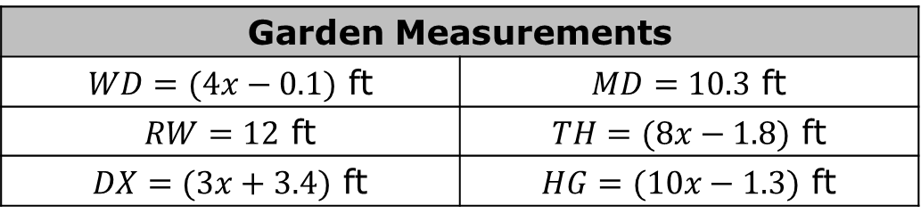
The garden’s measurements are given in the table.
Garden Measurements
$WD=(4x−0.1)$ ft | $MD=10.3$ ft
$RW=12$ ft | $TH=(8x−1.8)$ ft
$DX=(3x+3.4)$ ft | $HG=(10x−1.3)$ ft
Determine the perimeter of the garden. Show your work.
volume 1, pg. 278

Slide 15
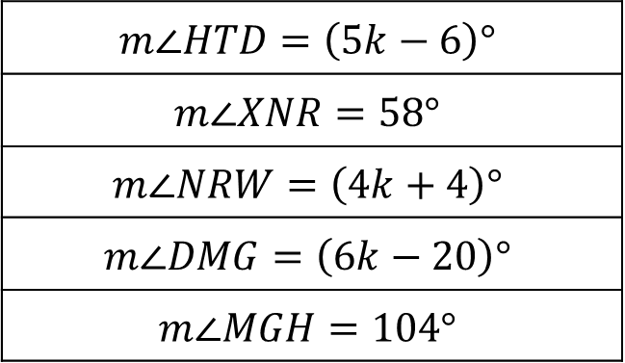
Once the garden has been installed, Dajon will check the angles of the polygons.
$$m∠HTD=\left(5k−6\right)°$$
$$m∠XNR=58°$$
$$m∠NRW=\left(4k+4\right)°$$
$$m∠DMG=\left(6k−20\right)°$$
$$m∠MGH=104°$$
Determine what measurement, in degrees, Dajon should use to check $m∠XDW$. Show your work.
volume 1, pg. 279

Slide 16

Your Turn
volume 1, pg. 279

Slide 17
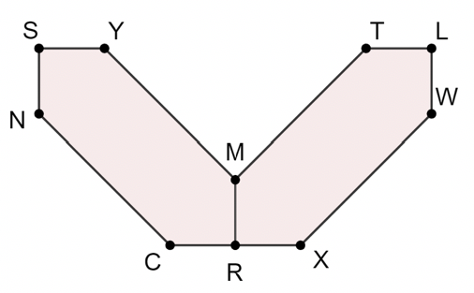
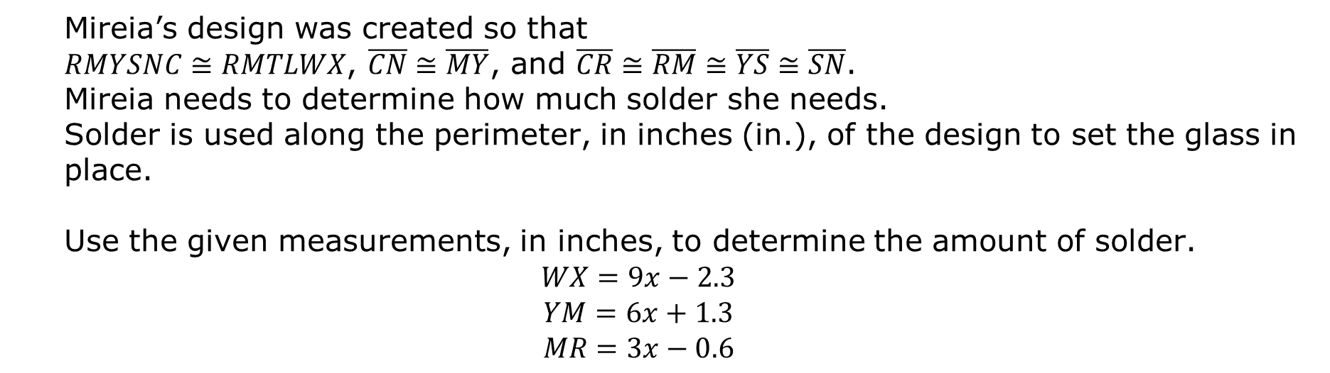
5.10.4 Your Turn!
Mireia is learning how to make stained glass in art class. She has created a design and labeled the vertices to help her keep track of the measurements. Her design is shown.
Mireia’s design was created so that
$RMYSNC≅RMTLWX$, $\overline{CN}≅\overline{MY}$, and $\overline{CR}≅\overline{RM}≅\overline{YS}≅\overline{SN}$.
Mireia needs to determine how much solder she needs.
Solder is used along the perimeter, in inches (in.), of the design to set the glass in place.
Use the given measurements, in inches, to determine the amount of solder.
$$WX=9x−2.3$$
$$YM=6x+1.3$$
$$MR=3x−0.6$$
volume 1, pg. 279

Slide 18

Wrap-Up
volume 1, pg. 280

Slide 19
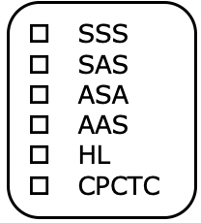
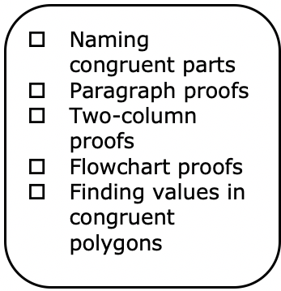
5.10.5 Wrap-Up: Reflection
Think back over this unit. If necessary, look back over the different lessons. Then, complete the sentence by checking all that apply.
I don’t understand …. YET.
Do(does) NOT make sense…YET.
volume 1, pg. 280

Slide 20
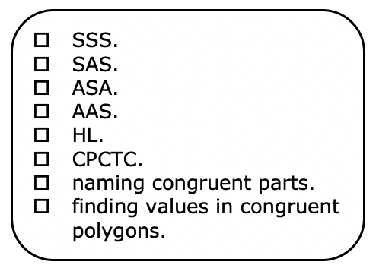
I can explain
volume 1, pg. 280

